Slide 1
Semantic Analysis

Slide 2
Program is lexically well-formed:
Identifiers have valid names.
Strings are properly terminated.
No stray characters.
Program is syntactically well-formed:
Class declarations have the correct structure.
Expressions are syntactically valid.
Does this mean that the program is legal?

Slide 3
Semantic Analysis
Ensure that the program has a well-defined meaning.
Verify properties of the program that aren't caught during the earlier phases:
Variables are declared before they're used.
Expressions have the right types.
Arrays can only be instantiated with NewArray.
Classes don't inherit from nonexistent base classes …
Once we finish semantic analysis, we know that the user's input program is legal.

Slide 4
Syntax Directed Translation: Intro
The Principle of Syntax Directed Translation states that the meaning of an input sentence is related to its syntactic structure, i.e., to its Parse-Tree.
By Syntax Directed Translations we indicate those formalisms for specifying translations for programming language constructs guided by context-free grammars.
We associate Attributes to the grammar symbols representing the language constructs.
Values for attributes are computed by Semantic Rules associated with grammar productions.

Slide 5
Syntax Directed Translation: Intro (Cont.)
Evaluation of Semantic Rules may:
Generate Code;
Insert information into the Symbol Table;
Perform Semantic Check;
Issue error messages; etc.

Slide 6
Attribute Grammars
We can turn this into an attribute grammar as follows : E → E + T E1.val = E2.val + T.val E → E – T E1.val = E2.val - T.val E → T E.val = T.val T → T * F T1.val = T2.val * F.val T → T / F T1.val = T2.val / F.val T → F T.val = F.val F → - F F1.val = - F2.val F → (E) F.val = E.val F → const F.val = C.val

Slide 7
Syntax Directed Definitions (Cont.)
The value of an attribute of a grammar symbol at a given parse-tree node is defined by a semantic rule associated with the production used at that node.
We distinguish between two kinds of attributes:
Synthesized Attributes. They are computed from the values of the attributes of the children nodes.
Inherited Attributes. They are computed from the values of the attributes of both the siblings and the parent nodes.

Slide 8
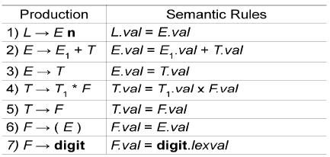
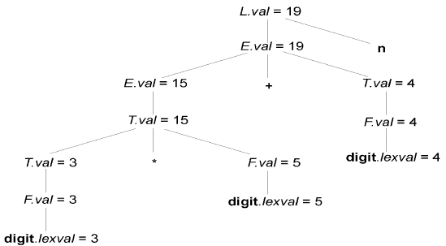
Evaluating an SDD at the Nodes of a Parse Tree
val and lexval are synthesized attributes
Annotated parse tree: 3*5 + 4 n
With synthesized attributes, we can evaluate attributes in any bottom-up order, such as that of a postorder traversal of the parse tree.

Slide 9
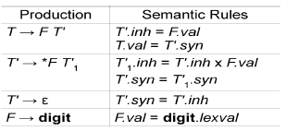
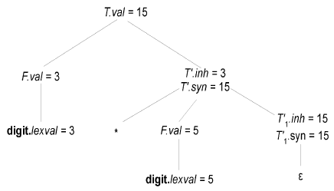
Evaluating an SDD at the Nodes of a Parse Tree
Annotated parse tree: 3*5
An SDD with both inherited and synthesized attributes does not ensure any guaranteed order; even it may not have an order at all.

Slide 10
S-Attributed Definitions
An SDD is S-attributed if every attribute is synthesized.
Attributes of an S-attributed SDD can be evaluated in bottom-up order of the nodes of parse tree.
Evaluation is simple using post-order traversal.
postorder(N) {
for (each child C of N, from the left)
postorder(C);
evaluate attributes associated with node N;
}
S-attributed definitions can be implemented during bottom-up parsing as
bottom-up parse corresponds to a postorder traversal
postorder corresponds to the order in which an LR parser reduces a production body to its head

Slide 11
L-Attributed Definitions
Each attribute must be either
Synthesized, or
Inherited, but with the rules limited as follows.
Suppose that there is a production A X₁ X₂ • • • X_{n}, there is an inherited attribute X_{i}.a computed by a rule associated with this production. Then the rule may use only:
Inherited attributes associated with the head A.
Either inherited or synthesized attributes associated with the occurrences of symbols X₁ X₂ • • • X_{i-1} located to the left of X_{i}
Inherited or synthesized attributes associated with this occurrence of X_{i} itself, but only in such a way that there are no cycles in a dependency graph formed by the attributes of this X_{i}.

